Slide 1
Client Side Attack

Slide 2
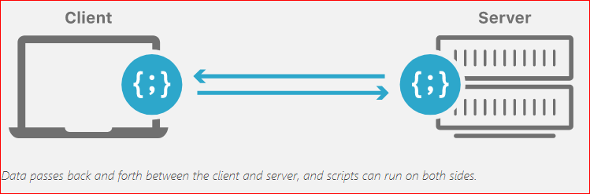

Client side attack
Attack client indirectly
Attack client directly

Slide 3
Introduction
Don’t need IP
Need user interaction
Need get users’ information

Slide 4

Client side attack -backdoor
Steps:
Generate a backdoor
Move a backdoor to a victim’s PC
Attacker listens the victim's PC
Backdoor contacts Attackers IP
Attacker accesses victim's PC
Notes:
Don’t need IP (only need attacker’s IP)
Need user interaction (to have backdoor installed)
Need get users’ information (e.g., OS)
Attacker: 10.0.2.10

Slide 5
Using veil-framework to Create a Backdoor and Access Victim’s PC

Slide 6

Introduction
Veil Framework
a tool designed to generate different payloads (backdoor) for metasploit
payloads can bypass common anti-virus solutions.
metasploit uses msfconsole
handles the incoming connection.
a part of Metasploit Framework
Reverse http
victim acts as client. Not the attack.
Backdoor connect to me (attacker) to void anti-virus detection.

Slide 7
Backdoor generation

Slide 8
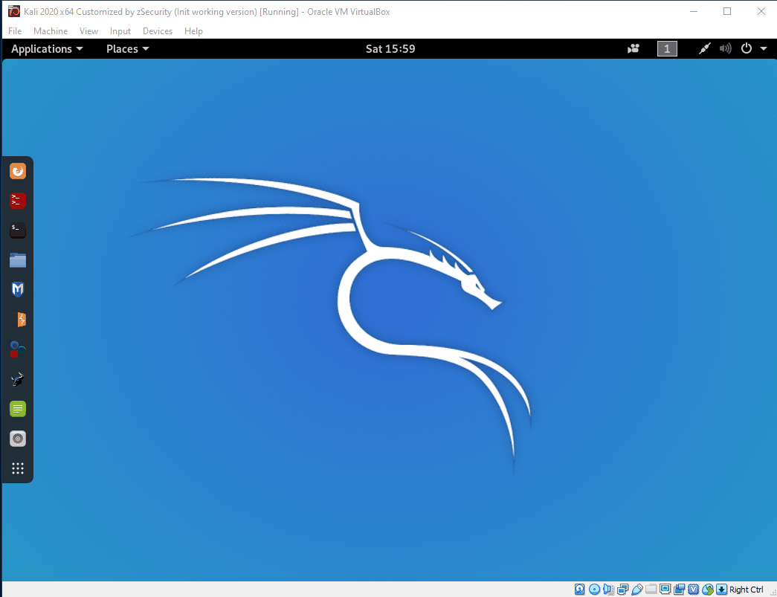
Install Veil in Kali (Animation)

Slide 9
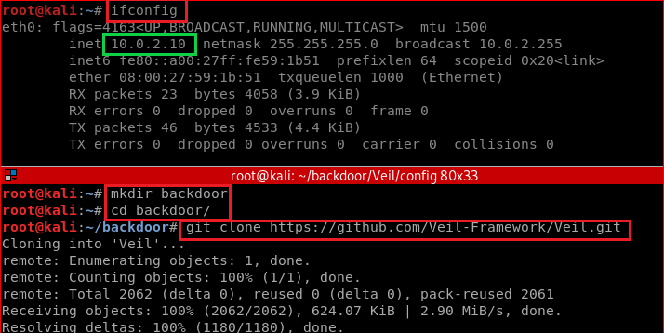
Install Veil in Kali

Slide 10
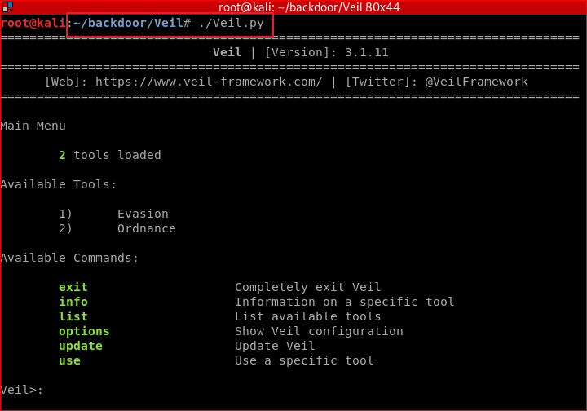
Notes:
./setup.sh --force --silent

Slide 11
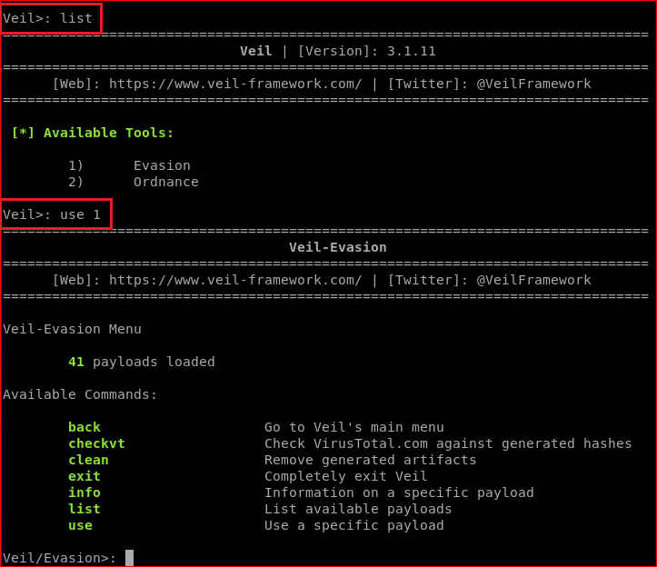
Attacker set payload options using Veil

Slide 12
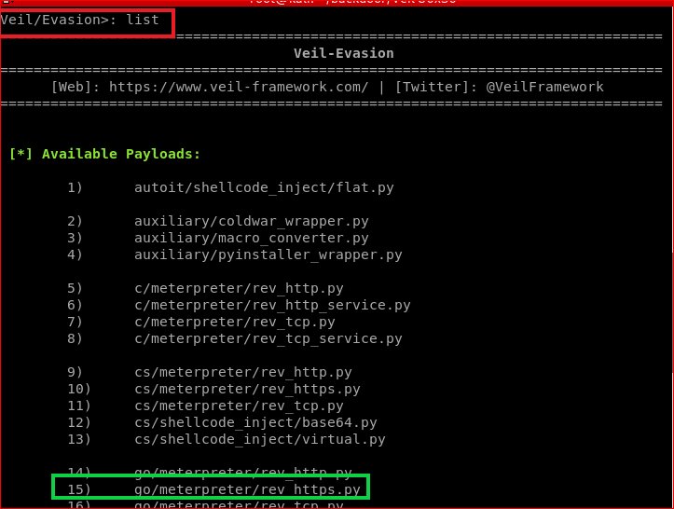

Slide 13
Generate listener using Meterpreter

Slide 14
Meterpreter
Is a Metasploit attack payload that provides an interactive shell to the attacker from which to explore the target machine and execute code.
Listener: A payload within the Metasploit Framework
Command center: Provides control over an exploited target system, running as a DLL loaded inside of any process on a target machine.

Slide 15
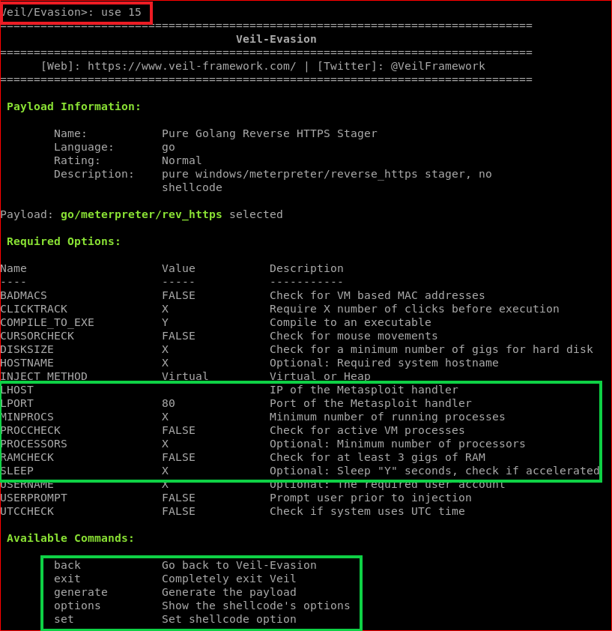

Slide 16
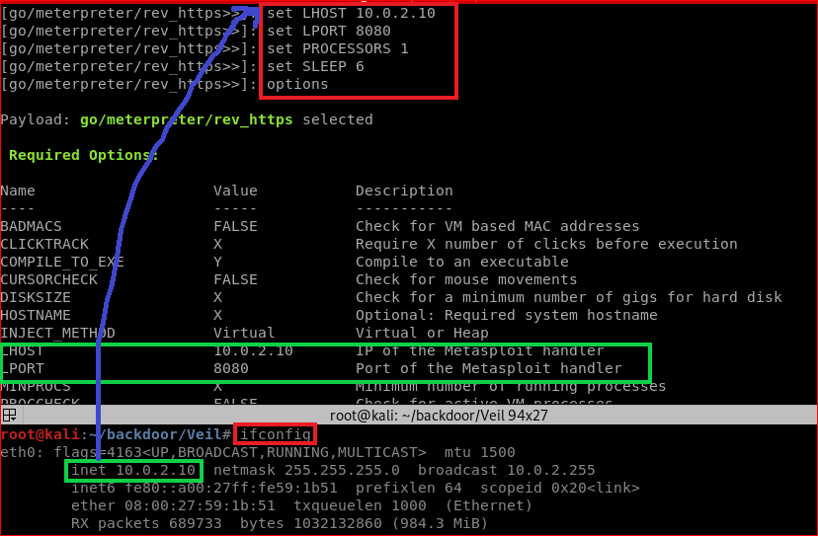

Slide 17
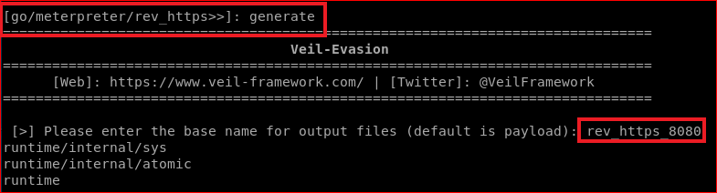
Generate backdoor payload (executable)

Slide 18
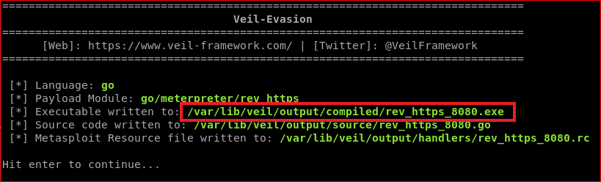
Verify

Slide 19
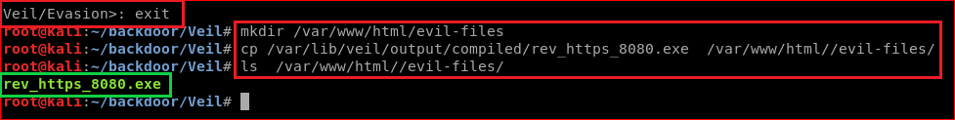
Attacker loads the backdoor to a website
cp /var/lib/veil/output/compiled/rev_https_8080.exe /var/www/html/evil-files/
Notes:
cp /var/lib/veil/output/compiled/rev_https_8080.exe /var/www/html//evil-files/

Slide 20
Gaining Access To Victim's PC

Slide 21
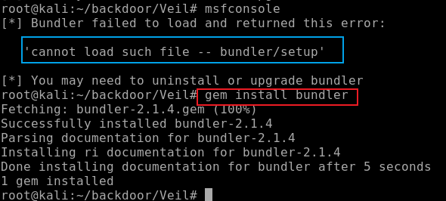
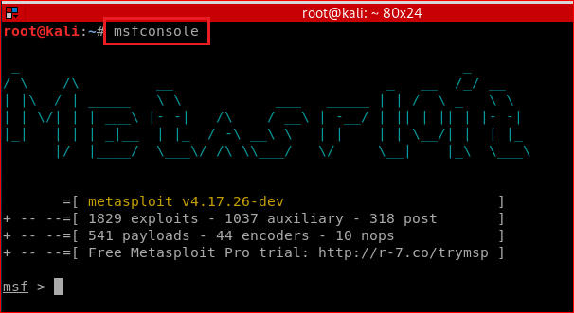
Attacker listening incoming connection (Sever/Attacker side/Kali)
Trouble shooting for Kali 2020

Slide 22
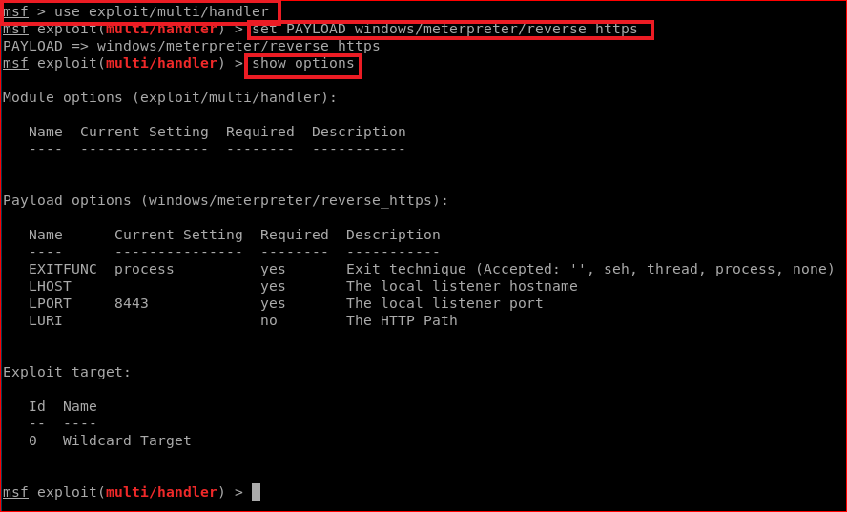
set PAYLOAD
reverse_https

Slide 23
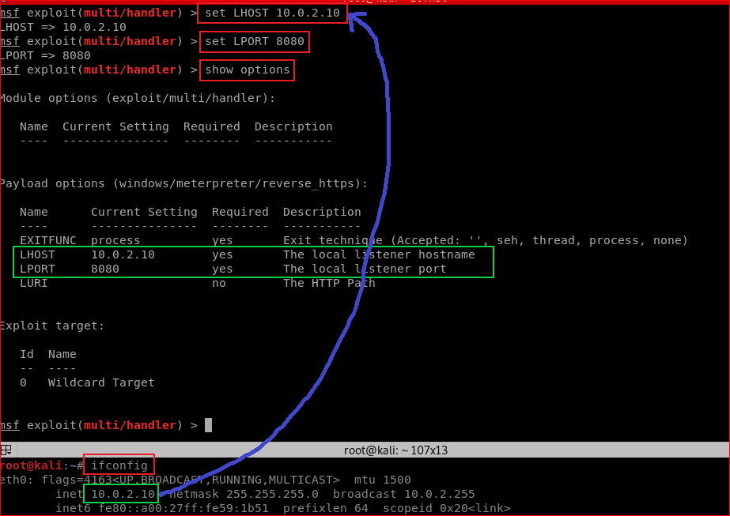

Slide 24
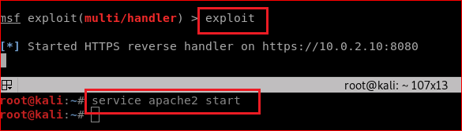

Slide 26
Disable Windows 10 Defender
We will use Window 10 as the victim PC. Don’t use Win 7. May work on Windows 8, but I have not tried

Slide 27
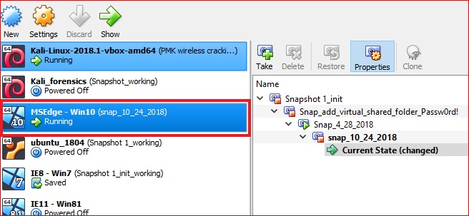

Slide 28
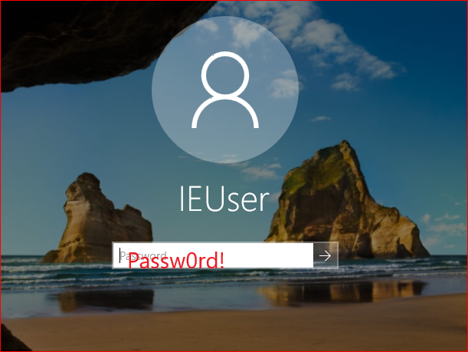

Slide 29
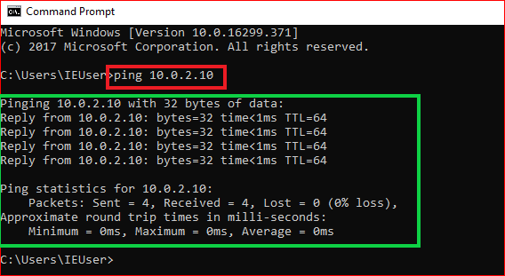
Confirm victim/Window 10 and attacker/kali in the same network

Slide 30
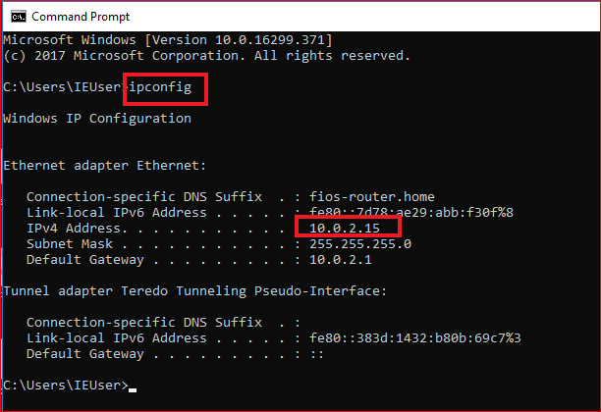
Don’t need to know the victim’s IP. Nothing to do with the attack

Slide 31
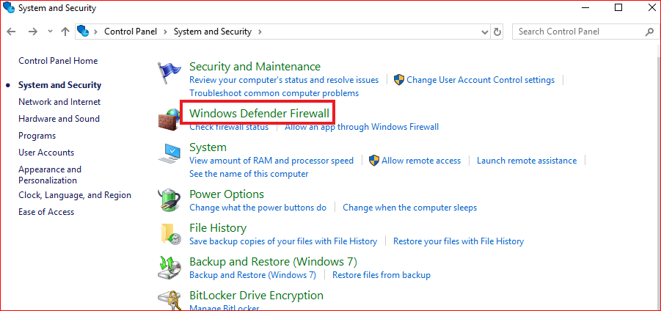
Turn off Firewall

Slide 32
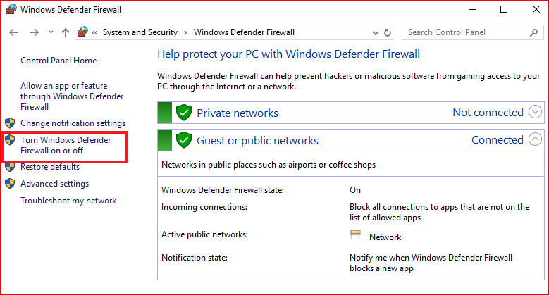

Slide 33
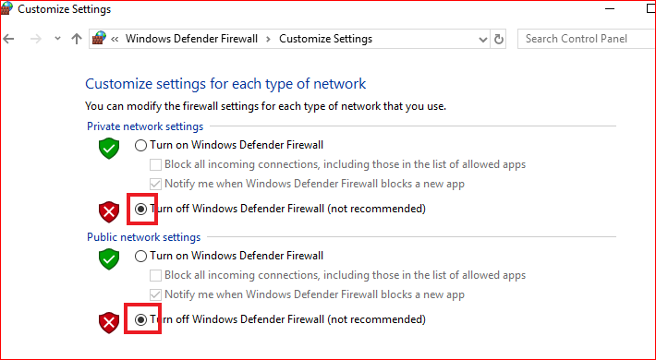

Slide 34
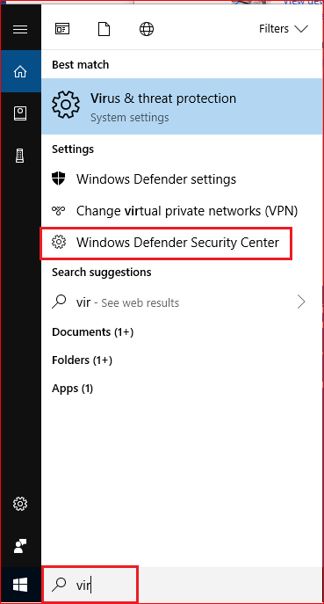
Turn off virus protection

Slide 35
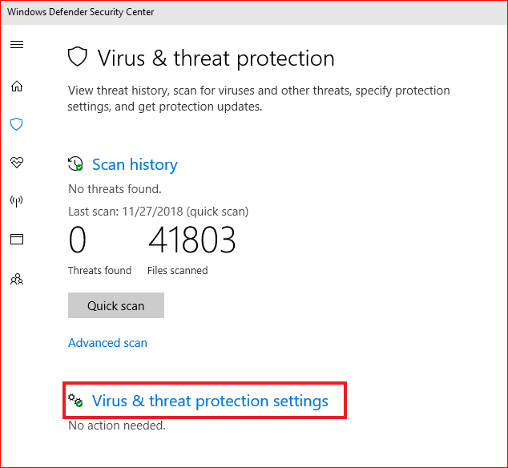

Slide 36
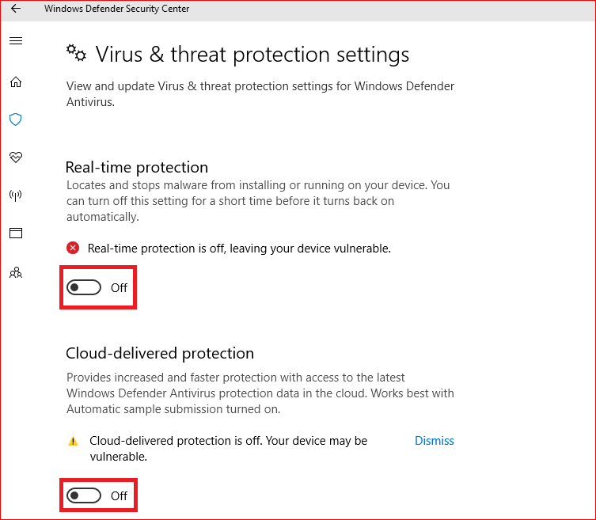

Slide 37
Victim click the backdoor

Slide 38
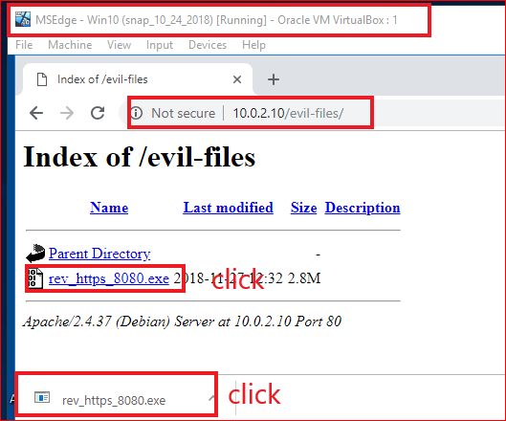
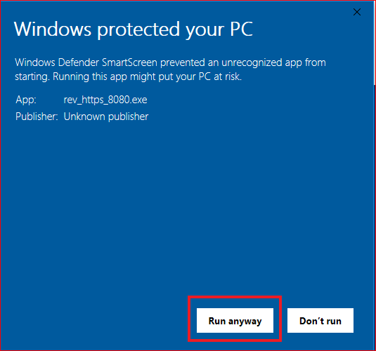

Slide 39
Attack gain access to victim’s PC

Slide 40
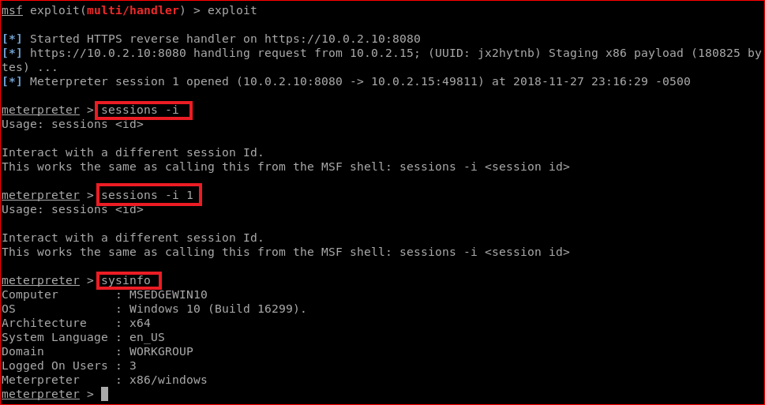

Slide 41
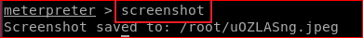
Attack take screenshots of victim’s PC

Slide 42
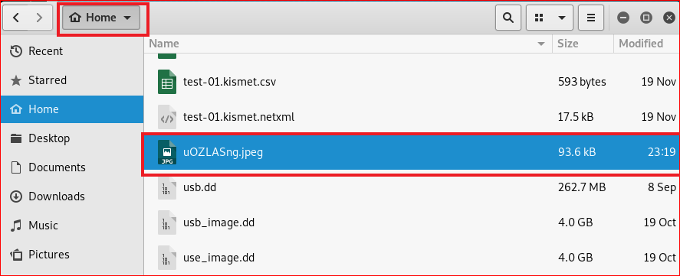
Show victim’s screenshots

Slide 43
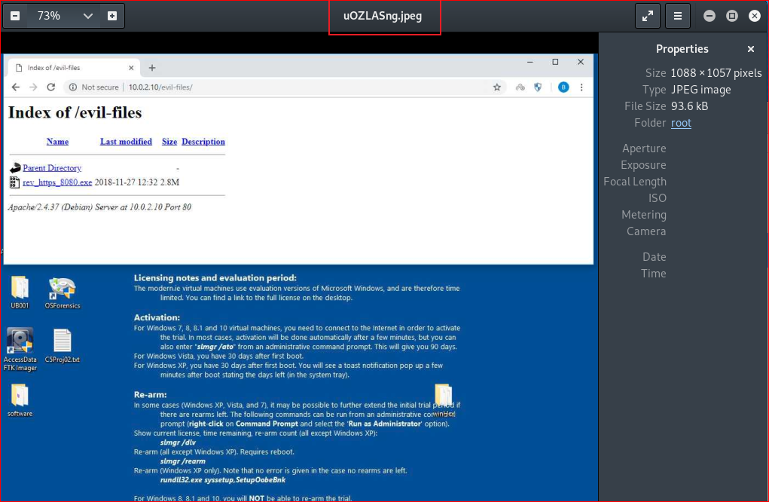

Slide 44
Things you need to try
keyscan_start (enable key logger)
(in Window VM, open facebook, type your password)
keyscan_dump (what did you see?)
keyscan_stop

Slide 45
Questions
Can you change the backdoor and bypass Windows security check? Try and show me the results.

